Slide 1




TRAINING
SESSION

Slide 2
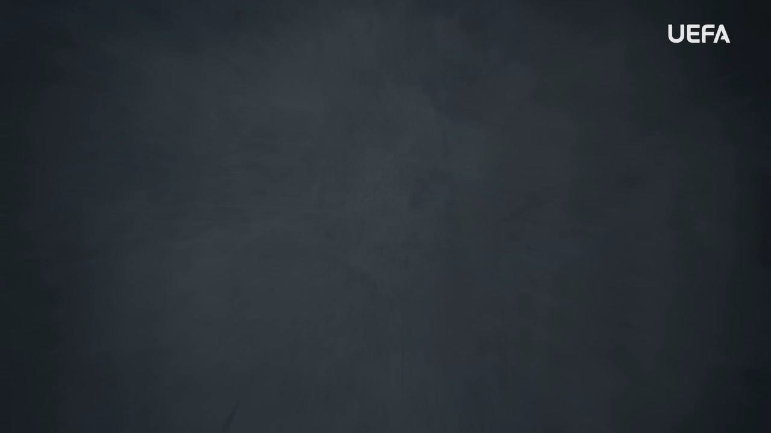
INTRODUCTION
WELCOME
Welcome to this OUTRAGED Education Session.
SESSION AIMS:
Watch the UEFA OUTRAGED HOMOPHOBIA video and then hold an open discussion about how we as individuals but also as a group, can ensure that
homophobia has no place in football.
Notes:
This section outlines a suggested text to use as an introduction to the session:
“Welcome to this OUTRAGED session. The aim is for us to come together to watch the UEFA video on homophobia, and then hold an open discussion about preventing and fighting this form of discrimination in football. I am here as your session leader today. I am happy to be able to share this experience with you, and hope that we can come together to create a safe and open space for discussion. Together we will look at how we as individuals but also as a group, can ensure that homophobia has no place in football. When speaking about homophobia, we speak about the fear or dislike of someone, based on prejudice or negative attitudes, beliefs or views about lesbian, gay or bi people. This can also include denying somebody’s lesbian, gay or bi identity or refusing to accept it. It is the targeting of people based on who/what they are attracted to or choose to love. There are many different sexual orientations, and some of these are:
• Heterosexual – attraction between a man
and a woman
• Homosexual –same sex attraction
between, for example 2 men, or 2
women
• Bi-sexual – attraction to the same sex and
opposite sex
Homophobia can include hateful and discriminatory actions, activities, words, and symbols that are based on the idea that being heterosexual is the only acceptable sexual orientation. It is a form of discrimination that is one of many aspects of what is called LGBTQI+ hate, which also includes aspects of how individuals see themselves - as a girl/woman, or a boy/man, or neither. Homophobia and LGBTQI+ hate have no place in football. As players, and as a team, you can all play a part in ensuring that no one faces homophobia within the game. The work we do here today is a part of the UEFA OUTRAGED educational project, and I will provide them some key information about the session. If you feel like you would like to speak further about any of the aspects we cover today, please reach out to me in the end of the session.
UEFA, the Football Association of Wales and (INSERT CLUB NAME) thanks you for being a part of this project, and this session is one of many which will look to change the football environment for the better.”

Slide 3
PART 1:
OUTRAGED
VIDEO VIEWING

Slide 4

OUTRAGED VIDEO
Let’s watch the OUTRAGED HOMOPHOBIA video!
Notes:
https://www.uefa.tv/video/vod/376095/?playlistId=11230

Slide 5
PART 2:
DISCUSSION

Slide 6
DISCUSSION
HOMOPHOBIA AND LGBTQI+ HATE
The video shows an array of people speaking about the situation for the LGBTQI+ community in football.
Q: If you or someone in your team experienced homophobia or LGBTQI+ hate, what would you do?
Group conversation prompts:
Would you speak up against this?
Would you report it to an adult
What would prevent you from speaking out
What feelings would this bring you?
Notes:
There is no need to cover all topics and questions. These are provided to ensure there is content for discussion, but engagement is the key, not how many topics or questions you get through! There may be topics not listed below that you feel are relevant to your group. Please amend/adapt the questions and topics as you see fit and let the group guide the discussion where possible.

Slide 7
DISCUSSION
THE SYMBOL OF THE RAINBOW FLAG
The rainbow flag and standing together for inclusion of all is a key topic in the video. While sexual orientation doesn’t impact the way you play, it is a topic that has shown to divide communities and fans.
Q: Why do you think it is important for the LGBTQI+ community to see the rainbow flag represented in football?
Group conversation prompts:
Seeing the bad behaviour related to homophobia, do you think the flag is a way of sending a message (of support)?
Notes:
There is no need to cover all topics and questions. These are provided to ensure there is content for discussion, but engagement is the key, not how many topics or questions you get through! There may be topics not listed below that you feel are relevant to your group. Please amend/adapt the questions and topics as you see fit and let the group guide the discussion where possible.

Slide 8
DISCUSSION
LGBTQI+ INCLUSION
Love, and expressing who you are, are important aspects in feeling like you can be yourself. Football should not be a place where this is limited, or where anyone feels like they need to hide who they are.
Q: What do you think are the main aspects of making anyone feel safe and welcomed in football?
Group conversation prompts:
How would you want to feel when you join a team?
How important is it to be able to feel like you can be yourself at all times?
Notes:
There is no need to cover all topics and questions. These are provided to ensure there is content for discussion, but engagement is the key, not how many topics or questions you get through! There may be topics not listed below that you feel are relevant to your group. Please amend/adapt the questions and topics as you see fit and let the group guide the discussion where possible.

Slide 9

QUESTIONS?
THOUGHTS & FEEDBACK
Do you have any questions?
Notes:
There is no need to cover all topics and questions. These are provided to ensure there is content for discussion, but engagement is the key, not how many topics or questions you get through! There may be topics not listed below that you feel are relevant to your group. Please amend/adapt the questions and topics as you see fit and let the group guide the discussion where possible.

Slide 10

FURTHER SUPPORT
If you experience discrimination or have any concerns, contact….
Notes:
Provide details of dedicated contact person at your Club i.e. safeguarding officer or Liaison Officer.

Slide 11


Notes:
“Thank you all for your work here today. I hope that you all take three things away from today:
1. We all play a role in making sure that football is welcoming for all – you, your club, the National Association and UEFA.
2. Discrimination should never be accepted, and it is key that you feel comfortable speaking about these topics and know where to turn if you need support or to report an incident.
3. We are all here because of our love for football – let us leverage this to build an environment that represents values of respect, openness, and inclusion.
Based on these three things, you’ll be a part of the OUTRAGED educational project, working to make sure that there is no place for discrimination in European football.”

