Slide 1



TRAINING
SESSION

Slide 2
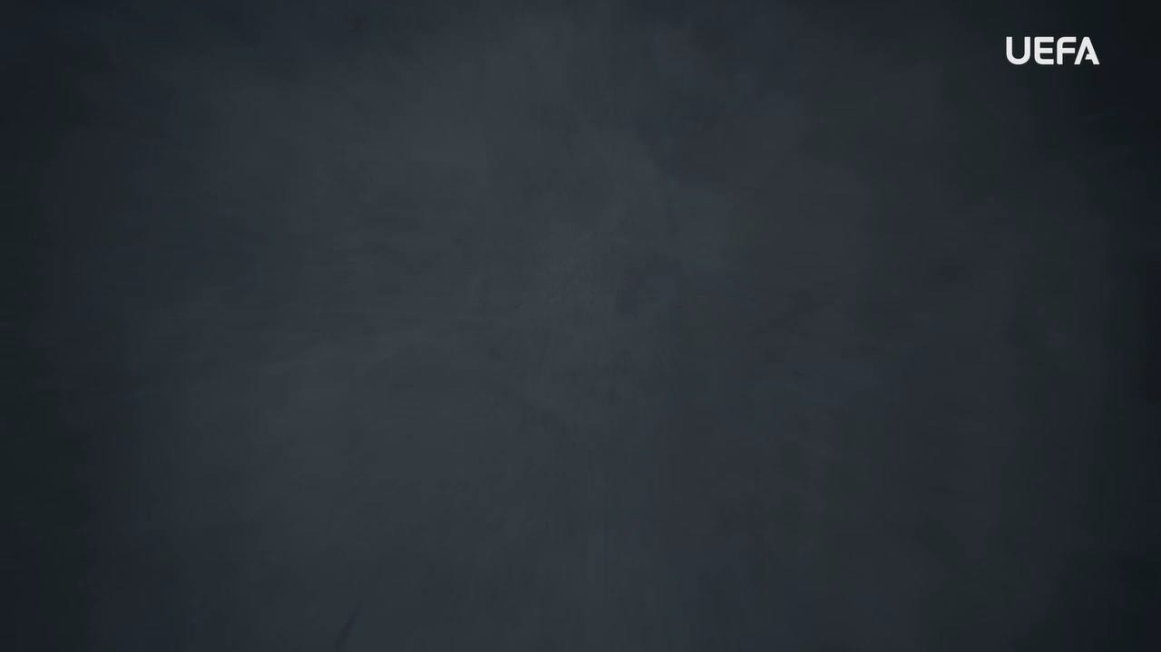
INTRODUCTION
WELCOME
Welcome to this OUTRAGED Education Session.
SESSION AIMS:
Watch the UEFA OUTRAGED ONLINE ABUSE video and then hold an open discussion about ensuring that online abuse has no place in football.
Notes:
This section outlines a suggested text to use as an introduction to the session:
“Welcome to this OUTRAGED session. The aim is for us to come together to watch the UEFA video on online abuse, and then hold an open discussion about preventing and fighting this form of discrimination in football. I am here as your session leader today. I am happy to be able to share this experience with you, and hope that we can come together to create a safe and open space for discussion. Together we will look at how we as individuals but also as a group, can look to ensure that online abuse has no place in football. When we speak about online abuse, we speak about hateful and abusive content shared on social media and online platforms. This can be in the form of texts, images, videos, or symbols, and can be directed towards individuals, groups, or communities. The online world is one where anyone can reach you, and where abusive content is not sufficiently regulated. It is easy for someone with bad intentions to post an abusive post, and it is often hard to identify and hold people accountable. We all need to be proactive in these spaces, and learn about how we can best protect ourselves, and stand up against online abuse by reporting abusive content to the social media platforms The work we do here today is a part of the UEFA OUTRAGED educational project, and I will provide them some key information about the session. If you feel like you would like to speak further about any of the aspects we cover today, please reach out to me in the end of the session.
UEFA, the Football Association of Wales and (INSERT CLUB NAME) thanks you for being a part of this project, and this session is one of many which will look to change the football environment for the better.”

Slide 3
PART 1:
OUTRAGED
VIDEO VIEWING

Slide 4

OUTRAGED VIDEO
Let’s watch the OUTRAGED ONLINE ABUSE video!
Notes:
https://www.uefa.tv/video/vod/376748/?playlistId=11230

Slide 5
PART 2:
DISCUSSION

Slide 6
DISCUSSION
ONLINE ABUSE
The video showcases several situations in which individuals in football has experienced online abuse, and how this has impacted them.
Q: What do you think makes online abuse such a big problem?
Group conversation prompts:
Can anyone go online and abuse others?
Is it easy to find the people behind the accounts online?
Notes:
There is no need to cover all topics and questions. These are provided to ensure there is content for discussion, but engagement is the key, not how many topics or questions you get through! There may be topics not listed below that you feel are relevant to your group. Please amend/adapt the questions and topics as you see fit and let the group guide the discussion where possible.

Slide 7
DISCUSSION
ACCESS TO PLAYERS
The video mentions that social media has provided a direct channel to speak to players, which was not there before.
Q: Do you feel comfortable with social media, knowing that it can bring issues of online abuse?
Group conversation prompts:
What do you think is most important to think about when it comes to online presence and online abuse?
Would you use settings to limit who can comment on your social media content, to reduce the risk of online abuse?
Notes:
There is no need to cover all topics and questions. These are provided to ensure there is content for discussion, but engagement is the key, not how many topics or questions you get through! There may be topics not listed below that you feel are relevant to your group. Please amend/adapt the questions and topics as you see fit and let the group guide the discussion where possible.

Slide 8
DISCUSSION
MANAGING ONLINE ABUSE
Presenting many experiences of online abuse, and how this can impact players and individuals, it is important to understand how to best manage online abuse.
Q: If you would see abusive content online, what would you do?
Group conversation prompts:
Do you know how to report content on the channels that you are active on?
If you saw something online that you think is not ok, what would you do?
Notes:
There is no need to cover all topics and questions. These are provided to ensure there is content for discussion, but engagement is the key, not how many topics or questions you get through! There may be topics not listed below that you feel are relevant to your group. Please amend/adapt the questions and topics as you see fit and let the group guide the discussion where possible.

Slide 9

QUESTIONS?
THOUGHTS & FEEDBACK
Do you have any questions?
Notes:
There is no need to cover all topics and questions. These are provided to ensure there is content for discussion, but engagement is the key, not how many topics or questions you get through! There may be topics not listed below that you feel are relevant to your group. Please amend/adapt the questions and topics as you see fit and let the group guide the discussion where possible.

Slide 10

FURTHER SUPPORT
If you experience discrimination or have any concerns, contact….
Notes:
Provide details of dedicated contact person at your Club i.e. safeguarding officer or Liaison Officer.

Slide 11


Notes:
“Thank you all for your work here today. I hope that you all take three things away from today:
1. We all play a role in making sure that football is welcoming for all – you, your club, the National Association and UEFA.
2. Discrimination should never be accepted, and it is key that you feel comfortable speaking about these topics and know where to turn if you need support or to report an incident.
3. We are all here because of our love for football – let us leverage this to build an environment that represents values of respect, openness, and inclusion.
Based on these three things, you’ll be a part of the OUTRAGED educational project, working to make sure that there is no place for discrimination in European football.”

