Slide 1


PARENT
TRAINING
SESSION

Slide 2
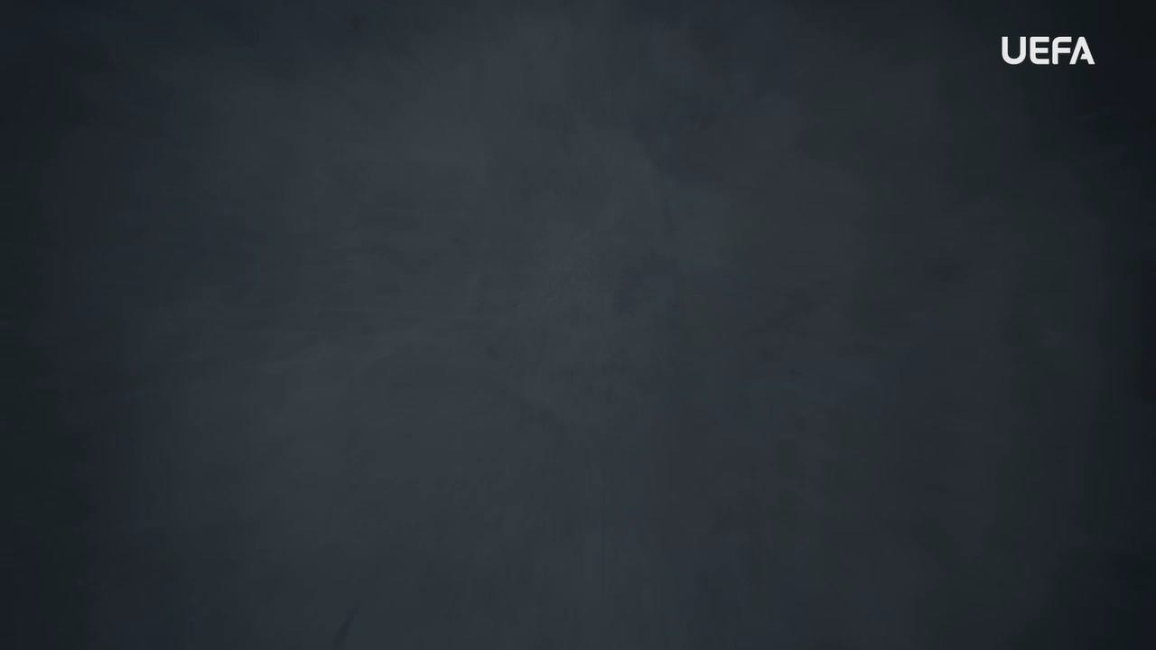
INTRODUCTION
WELCOME
Welcome to this OUTRAGED Education Session.
SESSION AIMS:
Watch the UEFA OUTRAGED video and then hold an open discussion about preventing and fighting discrimination in football.
Notes:
This section outlines a suggested text to use as an introduction to the session:
“ Welcome to this OUTRAGED session. The aim is for us to come together to watch the UEFA video, and then hold an open discussion about preventing and fighting discrimination in football.
I am here as your session leader today. I am happy to be able to share this experience with you, and hope that we can come together to create a safe and open space for discussion. Together we will look at how we as individuals but also as a group, can look to fight discrimination. As a parent of a player, you are aware of the benefits that football and sport can bring, but of course also about the harms
that discrimination can bring. We are here today to discuss and share ideas around our roles and responsibilities around the topic of discrimination in football, as well as outside
of the sport.
This project is based on the idea that discussion will strengthen the joint values of respect, and to also provide a platform for all involved in football to relate and connect, to work together to eradicate discrimination in football. We can only achieve this through collaboration, and as a parent you are a very important player.
The work we do here today is a part of the UEFA OUTRAGED educational project, and I will provide them some key information about the session. If you feel like you would like to speak further about any of the aspects we cover today, please reach out to me in the end of the session.
UEFA, the Football Association of Wales and (INSERT FC NAME) thanks you for being a part of this project, and this session is one of many which will look to change the football environment for the better.”

Slide 3
PART 1:
OUTRAGED
VIDEO VIEWING

Slide 4

OUTRAGED VIDEO
Let’s watch the OUTRAGED video!
Notes:
https://www.uefa.tv/video/vod/376097/?playlistId=11230

Slide 5
PART 2:
DISCUSSION

Slide 6
DISCUSSION
DISCRIMINATION
Throughout the film footballers, coaches and fans share their personal experience of witnessing and being subjected to verbal and physical threats and abuse.
Q: What are your fears and concerns regarding discrimination in football?
Group conversation prompts:
Do you have concerns for your child in regard to discrimination within the football environment?
Do you feel this is an issue that could impact your child’s interest in the sport?
Notes:
There is no need to cover all topics and questions. These are provided to ensure there is content for discussion, but engagement is the key, not how many topics or questions you get through! There may be topics not listed below that you feel are relevant to your group. Please amend/adapt the questions and topics as you see fit and let the group guide the discussion where possible.

Slide 7
DISCUSSION
TYPES OF DISCRIMINATION
The OUTRAGED series includes the topics of racism, sexism, homophobia, refugee discrimination and online abuse.
Q: How do you see your role as a parent regarding educating and supporting your child around these topics?
Group conversation prompts:
Would you feel prepared to speak to your child about these issues?
Would you see this as a joint engagement with other adults in the football environment, if so with whom?
Notes:
There is no need to cover all topics and questions. These are provided to ensure there is content for discussion, but engagement is the key, not how many topics or questions you get through! There may be topics not listed below that you feel are relevant to your group. Please amend/adapt the questions and topics as you see fit and let the group guide the discussion where possible.

Slide 8
DISCUSSION
SPECTATOR AND CROWD ACTIVITIES
In the video, we see several examples of racist and homophobic abuse by crowds in the form of offensive chanting and displaying abusive banners.
Q: How would you speak to your child if this happened in a match that
they played in?
Group conversation prompts:
What would be your main messages, but also your main concerns?
Notes:
There is no need to cover all topics and questions. These are provided to ensure there is content for discussion, but engagement is the key, not how many topics or questions you get through! There may be topics not listed below that you feel are relevant to your group. Please amend/adapt the questions and topics as you see fit and let the group guide the discussion where possible.

Slide 9
DISCUSSION
SPECTATOR AND CROWD ACTIVITIES
Widespread access to social media has made it easy to communicate with those involved in football at all levels of football. The film outlines some of the online racist, homophobic and sexist abuse that top level players have experienced.
Q: What are your main concerns regarding online abuse, and do you actively speak to your child about this?
Group conversation prompts:
Is your child active on social media, and if so, are you aware of their security settings?
Do you feel like you know how to best protect your child in relation to online abuse?
Notes:
There is no need to cover all topics and questions. These are provided to ensure there is content for discussion, but engagement is the key, not how many topics or questions you get through! There may be topics not listed below that you feel are relevant to your group. Please amend/adapt the questions and topics as you see fit and let the group guide the discussion where possible.

Slide 10
COMMITMENT
WHAT CAN WE DO?
The video highlights experiences, but also speaks about what can be done to fight and prevent discrimination in football.
Q: What can we do, as individuals and together, to prevent and fight discrimination of all kinds?
Use the OUTRAGED Commitment card to write down 3 actions that you will commit to following the session.
Notes:
Before closing the session, dedicate time to Discuss the commitment of the group for active work. Based on the discussions around the previous points, work with the group to identify minimum 3 actions that the group will commit to implement in a timeframe appropriate to your group/organisation’s context.

Slide 11

QUESTIONS?
THOUGHTS & FEEDBACK
Do you have any questions?
Notes:
There is no need to cover all topics and questions. These are provided to ensure there is content for discussion, but engagement is the key, not how many topics or questions you get through! There may be topics not listed below that you feel are relevant to your group. Please amend/adapt the questions and topics as you see fit and let the group guide the discussion where possible.

Slide 12

FURTHER SUPPORT
If you experience discrimination or have any concerns, contact….
Notes:
Provide details of dedicated contact person at your Club i.e. safeguarding officer or Liaison Officer.

Slide 13


Notes:
“Thank you all for your work here today. I hope that you all take three things away from today:
1. We all play a role in making sure that football is welcoming for all – you, your club, the National Association and UEFA.
2. Discrimination should never be accepted, and it is key that you feel comfortable speaking about these topics and know where to turn if you need support or to report an incident.
3. We are all here because of our love for football – let us leverage this to build an environment that represents values of respect, openness, and inclusion.
Based on these three things, you’ll be a part of the OUTRAGED educational project, working to make sure that there is no place for discrimination in European football.”

