Slide 1


PLAYER
TRAINING
SESSION

Slide 2
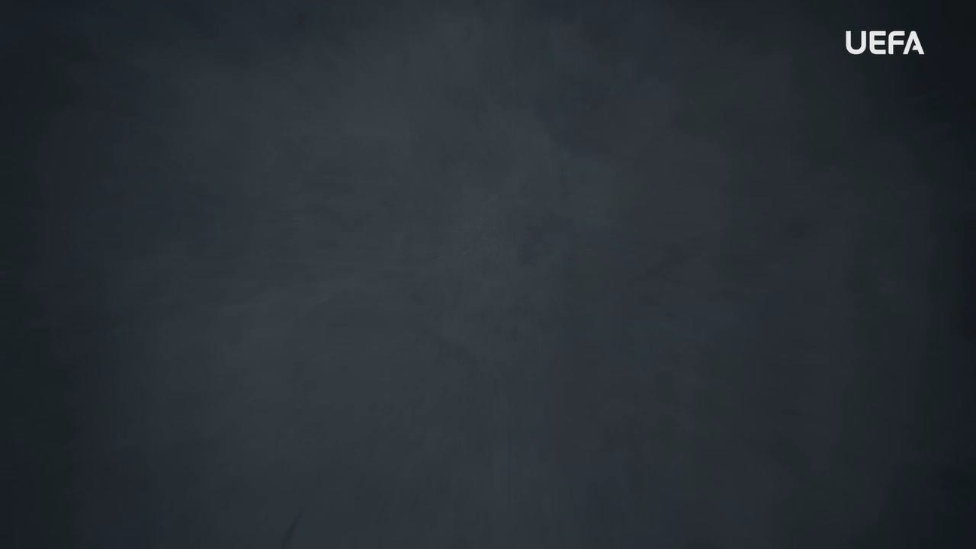
INTRODUCTION
WELCOME
Welcome to this OUTRAGED Education Session.
SESSION AIMS:
Watch the UEFA OUTRAGED video and then hold an open discussion about preventing and fighting discrimination in football.
Notes:
This section outlines a suggested text to use as an introduction to the session:
“Welcome to this OUTRAGED session. Today we will be watching a UEFA video about discrimination in football, and we will work together and discuss some of the topics of the video, and how we can act to fight discrimination in football. I am here as your session leader today. I am happy to be able to share this experience with you, and hope that we can come together to create a safe and open space for discussion. Together we will also look at how we can ensure everyone feels welcome in football. As players, I hope you are all here because you enjoy the game. Looking at the fun that we have on the pitch, it is important that we work together to ensure that everyone feels like they can enjoy the game and have fun on and off the pitch. You and your teammates can all play a role in making this happen, and this is what we are hoping to talk about today. The work we do here today is a part of the UEFA OUTRAGED educational project, and I will provide them some key information about the session. If you feel like you would like to speak further about any of the aspects we cover today, please reach out to me in the end of the session.
UEFA, the Football Association of Wales and (INSERT FC NAME) thanks you for being a part of this project, and this session is one of many which will look to change the football environment for the better.”

Slide 3
PART 1:
OUTRAGED
VIDEO VIEWING

Slide 4

OUTRAGED VIDEO
Let’s watch the OUTRAGED video!
Notes:
https://www.uefa.tv/video/vod/376097/?playlistId=11230

Slide 5
PART 2:
DISCUSSION

Slide 6
DISCUSSION
DISCRIMINATION
Throughout the film footballers, coaches and fans share their personal experience of witnessing and being subjected to verbal and physical threats and abuse.
Q: How do you think discrimination affects people?
Group conversation prompts:
Will it make them feel any specific emotions?
How would it make you feel?
Notes:
There is no need to cover all topics and questions. These are provided to ensure there is content for discussion, but engagement is the key, not how many topics or questions you get through! There may be topics not listed below that you feel are relevant to your group. Please amend/adapt the questions and topics as you see fit and let the group guide the discussion where possible.

Slide 7
DISCUSSION
HOW TO MANAGE DISCRIMINATION
Looking at the stories shared in the video, discrimination sadly exists in
football and society.
Q: If you see or experience discrimination, what would you do?
Group conversation prompts:
Would you say something to the person who does it?
Do you feel like you have an adult to who you can speak about this?
Notes:
There is no need to cover all topics and questions. These are provided to ensure there is content for discussion, but engagement is the key, not how many topics or questions you get through! There may be topics not listed below that you feel are relevant to your group. Please amend/adapt the questions and topics as you see fit and let the group guide the discussion where possible.

Slide 8
DISCUSSION
PREVENTING DISCRIMINATION
Many of the players speak about being part of the change in making sure that discrimination does not happen. Speaking about it is a first step towards this.
Q: Do you feel like your team creates an environment where you can speak about these topics? (In addition to the session here today.)
Group conversation prompts:
Have you ever spoken about topics like this before?
Notes:
There is no need to cover all topics and questions. These are provided to ensure there is content for discussion, but engagement is the key, not how many topics or questions you get through! There may be topics not listed below that you feel are relevant to your group. Please amend/adapt the questions and topics as you see fit and let the group guide the discussion where possible.

Slide 9

QUESTIONS?
THOUGHTS & FEEDBACK
Do you have any questions?
Notes:
There is no need to cover all topics and questions. These are provided to ensure there is content for discussion, but engagement is the key, not how many topics or questions you get through! There may be topics not listed below that you feel are relevant to your group. Please amend/adapt the questions and topics as you see fit and let the group guide the discussion where possible.

Slide 10

FURTHER SUPPORT
If you experience discrimination or have any concerns, contact….
Notes:
Provide details of dedicated contact person at your Club i.e. safeguarding officer or Liaison Officer.

Slide 11


Notes:
“Thank you all for your work here today. I hope that you all take three things away from today:
1. We all play a role in making sure that football is welcoming for all – you, your club, the National Association and UEFA.
2. Discrimination should never be accepted, and it is key that you feel comfortable speaking about these topics and know where to turn if you need support or to report an incident.
3. We are all here because of our love for football – let us leverage this to build an environment that represents values of respect, openness, and inclusion.
Based on these three things, you’ll be a part of the OUTRAGED educational project, working to make sure that there is no place for discrimination in European football.”

