Slide 1


PLAYER
TRAINING
SESSION

Slide 2
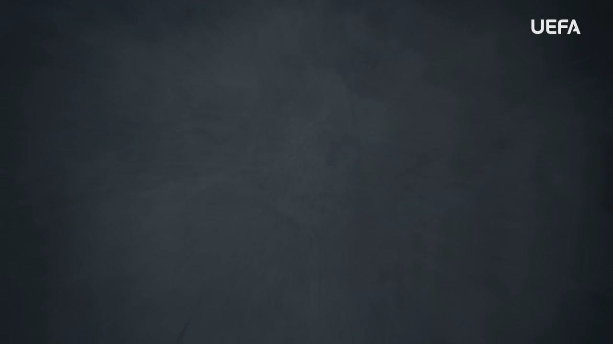
INTRODUCTION
WELCOME
Welcome to this OUTRAGED Education Session.
SESSION AIMS:
Watch the UEFA OUTRAGED video and then hold an open discussion about preventing and fighting discrimination in football.
Notes:
This section outlines a suggested text to use as an introduction to the session:
“Welcome to this OUTRAGED session. The aim is for us to come together to watch the UEFA video, and then hold an open discussion about preventing and fighting discrimination in football. I am here as your session leader today. I am happy to be able to share this experience with you, and hope that we can come together to create a safe and open space for discussion. Together we will also look at how we as individuals but also as a group, can look to fight discrimination. As a youth player, you are the future of football, and you already know how fun and exciting football can be. We are here today to speak about how we can work towards ensuring that football is fun and exciting for everyone both on and off the pitch. We are coming together to ensure no one is picked on, bullied, or harassed within football. Discrimination is hard to fight, but if we work together, we can, and even more importantly, we can prevent it. The work we do here today is a part of the UEFA OUTRAGED educational project, and I will provide them some key information about the session. If you feel like you would like to speak further about any of the aspects we cover today, please reach out to me in the end of the session.
UEFA, the Football Association of Wales and (INSERT FC NAME) thanks you for being a part of this project, and this session is one of many which will look to change the football environment for the better.”

Slide 3
PART 1:
OUTRAGED
VIDEO VIEWING

Slide 4

OUTRAGED VIDEO
Let’s watch the OUTRAGED video!
Notes:
https://www.uefa.tv/video/vod/376097/?playlistId=11230

Slide 5
PART 2:
DISCUSSION

Slide 6
DISCUSSION
DISCRIMINATION
Throughout the film footballers, coaches and fans share their personal experience of witnessing and being subjected to verbal and physical threats and abuse.
Q: How do you think this form of discrimination affects the targeted individuals?
Group conversation prompts:
Will it make them feel any specific emotions?
Will it affect their ability to play football?
How would you feel?
Notes:
There is no need to cover all topics and questions. These are provided to ensure there is content for discussion, but engagement is the key, not how many topics or questions you get through! There may be topics not listed below that you feel are relevant to your group. Please amend/adapt the questions and topics as you see fit and let the group guide the discussion where possible.

Slide 7
DISCUSSION
HOW TO MANAGE DISCRIMINATION
Looking at the stories shared in the video, discrimination sadly exists in
football and society.
Q: If you see or experience discrimination, what would you do?
Group conversation prompts:
Would you say something to the person who does it?
Do you feel like you have an adult to who you can speak about this?
Notes:
There is no need to cover all topics and questions. These are provided to ensure there is content for discussion, but engagement is the key, not how many topics or questions you get through! There may be topics not listed below that you feel are relevant to your group. Please amend/adapt the questions and topics as you see fit and let the group guide the discussion where possible.

Slide 8
DISCUSSION
SPECTATOR AND CROW ACTIVITIES
In the video, we see several examples of racist and homophobic abuse by crowds in the form of offensive chanting and displaying abusive banners.
Q: How do you think this issue should be dealt with? Who should be involved?
Group conversation prompts:
Who would you turn to if it happened in a match you are playing?
Notes:
There is no need to cover all topics and questions. These are provided to ensure there is content for discussion, but engagement is the key, not how many topics or questions you get through! There may be topics not listed below that you feel are relevant to your group. Please amend/adapt the questions and topics as you see fit and let the group guide the discussion where possible.

Slide 9
DISCUSSION
JOKING OR HARMING?
A number of footballers speak about the negative impact of what is known as ‘banter’ - defined as the playful and friendly exchange of teasing remarks - inside dressing rooms.
Q: Is banter and jokes a serious form of discrimination, or just harmless fun?
Group conversation prompts:
What is more important, how it is meant or how it is perceived?
Notes:
Ideally, the main message here should be that it does not matter if it is meant as a joke or banter, it is how it is or can be perceived that is important, and we should take a strong stance on this whenever possible.
There is no need to cover all topics and questions. These are provided to ensure there is content for discussion, but engagement is the key, not how many topics or questions you get through! There may be topics not listed below that you feel are relevant to your group. Please amend/adapt the questions and topics as you see fit and let the group guide the discussion where possible.

Slide 10

QUESTIONS?
THOUGHTS & FEEDBACK
Do you have any questions?
Notes:
There is no need to cover all topics and questions. These are provided to ensure there is content for discussion, but engagement is the key, not how many topics or questions you get through! There may be topics not listed below that you feel are relevant to your group. Please amend/adapt the questions and topics as you see fit and let the group guide the discussion where possible.

Slide 11

FURTHER SUPPORT
If you experience discrimination or have any concerns, contact….
Notes:
Provide details of dedicated contact person at your Club i.e. safeguarding officer or Liaison Officer.

Slide 12


Notes:
“Thank you all for your work here today. I hope that you all take three things away from today:
1. We all play a role in making sure that football is welcoming for all – you, your club, the National Association and UEFA.
2. Discrimination should never be accepted, and it is key that you feel comfortable speaking about these topics and know where to turn if you need support or to report an incident.
3. We are all here because of our love for football – let us leverage this to build an environment that represents values of respect, openness, and inclusion.
Based on these three things, you’ll be a part of the OUTRAGED educational project, working to make sure that there is no place for discrimination in European football.”

