Slide 1




TRAINING
SESSION

Slide 2
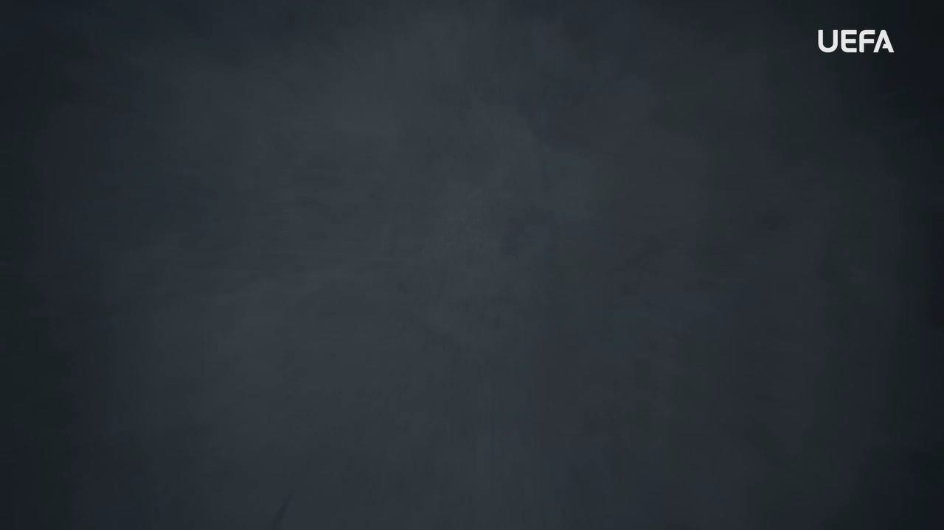
INTRODUCTION
WELCOME
Welcome to this OUTRAGED Education Session.
SESSION AIMS:
Watch the UEFA OUTRAGED RACISM video and then hold an open discussion about how we as individuals but also as a group, can look to eradicate racism in football.
Notes:
This section outlines a suggested text to use as an introduction to the session:
“Welcome to this OUTRAGED session. The aim is for us to come together to watch the UEFA video on racism, and then hold an open discussion about preventing and fighting this form of discrimination in football. I am here as your session leader today. I am happy to be able to share this experience with you, and hope that we can come together to create a safe and open space for discussion. Together we will look at how we as individuals but also as a group, can look to eradicate racism in football. When speaking about racism, we speak about hateful and discriminatory actions, activities, words, and symbols targeting a person/people because of their racial or ethnic background. Racism often finds its base in differences in skin colour, ethnicity, nationality, language, religion, customs or practices and place of birth, especially so as to distinguish them as inferior or superior to one another. Racism has no place in football. As players, and as a team, you can all play a part in ensuring that no one faces racism within the game. The work we do here today is a part of the UEFA OUTRAGED educational project, and I will provide them some key information about the session. If you feel like you would like to speak further about any of the aspects we cover today, please reach out to me in the end of the session.
UEFA, the Football Association of Wales and (INSERT CLUB NAME) thanks you for being a part of this project, and this session is one of many which will look to change the football environment for the better.”

Slide 3
PART 1:
OUTRAGED
VIDEO VIEWING

Slide 4

OUTRAGED VIDEO
Let’s watch the OUTRAGED RACISM video!
Notes:
https://www.uefa.tv/video/vod/376097/?playlistId=11230

Slide 5
PART 2:
DISCUSSION

Slide 6
DISCUSSION
RACISM
The colour of your skin should not matter, and it does not impact the way that anyone plays. However, racism has long been an issue in society and in football.
Q: What issues do you think racism brings to football?
Group conversation prompts:
Does it impact who wants to play?
Do you think it makes everyone feel like they can enjoy the game?
Does it make football dangerous?
Notes:
There is no need to cover all topics and questions. These are provided to ensure there is content for discussion, but engagement is the key, not how many topics or questions you get through! There may be topics not listed below that you feel are relevant to your group. Please amend/adapt the questions and topics as you see fit and let the group guide the discussion where possible.

Slide 7
DISCUSSION
STANDING UP AGAINST RACISM
Coming together and standing up against racism is an important aspect in creating a football welcoming for all. As Tyrone Mings says in the video: “If you are doing nothing about it, you are part of the problem”.
Q: Why do you think this is important?
Group conversation prompts:
What do you think is the right thing to do when something is unfair?
What different does it make if we come together on issues like racism instead of leaving it up to only the victims
to request change?
Notes:
There is no need to cover all topics and questions. These are provided to ensure there is content for discussion, but engagement is the key, not how many topics or questions you get through! There may be topics not listed below that you feel are relevant to your group. Please amend/adapt the questions and topics as you see fit and let the group guide the discussion where possible.

Slide 8
DISCUSSION
MANAGING RACISM
The video shows many examples of racist behaviours and situations of abuse against players.
Q: If you or someone in your team experienced racism, what would you do?
Group conversation prompts:
Would you speak up against this?
Would you report it to an adult?
What feelings would this bring you?
Notes:
There is no need to cover all topics and questions. These are provided to ensure there is content for discussion, but engagement is the key, not how many topics or questions you get through! There may be topics not listed below that you feel are relevant to your group. Please amend/adapt the questions and topics as you see fit and let the group guide the discussion where possible.

Slide 9

QUESTIONS?
THOUGHTS & FEEDBACK
Do you have any questions?
Notes:
There is no need to cover all topics and questions. These are provided to ensure there is content for discussion, but engagement is the key, not how many topics or questions you get through! There may be topics not listed below that you feel are relevant to your group. Please amend/adapt the questions and topics as you see fit and let the group guide the discussion where possible.

Slide 10

FURTHER SUPPORT
If you experience discrimination or have any concerns, contact….
Notes:
Provide details of dedicated contact person at your Club i.e. safeguarding officer or Liaison Officer.

Slide 11


Notes:
“Thank you all for your work here today. I hope that you all take three things away from today:
1. We all play a role in making sure that football is welcoming for all – you, your club, the National Association and UEFA.
2. Discrimination should never be accepted, and it is key that you feel comfortable speaking about these topics and know where to turn if you need support or to report an incident.
3. We are all here because of our love for football – let us leverage this to build an environment that represents values of respect, openness, and inclusion.
Based on these three things, you’ll be a part of the OUTRAGED educational project, working to make sure that there is no place for discrimination in European football.”

