Slide 1




TRAINING
SESSION

Slide 2
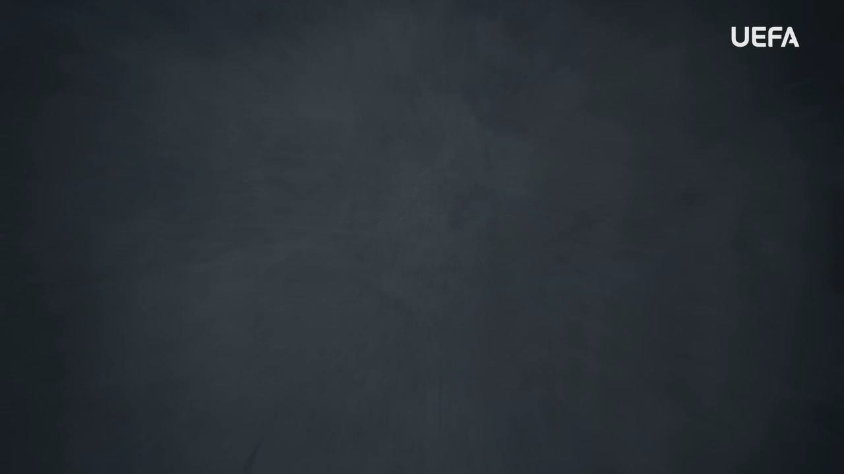
INTRODUCTION
WELCOME
Welcome to this OUTRAGED Education Session.
SESSION AIMS:
Watch the UEFA OUTRAGED REFUGEE DISCRIMINATION video and then hold an open discussion about preventing and fighting this discrimination towards refugees in football.
Notes:
This section outlines a suggested text to use as an introduction to the session:
“Welcome to this OUTRAGED session. The aim is for us to come together to watch the UEFA video on refugee discrimination, and then hold an open discussion about the topic around preventing and fighting this form of
discrimination in football. I am here as your session leader today. I am happy to be able to share this experience with you, and hope that we can come together to create a safe and open space for discussion. Together we will look at how we as individuals but also as a group, can look to fight against refugee discrimination in football. When we speak about refugee discrimination, we speak about hateful and discriminatory actions, activities, words, and symbols that are based on the idea that those who are not born in our country - but who are here as refugees, escaping war or a crisis in their home country - are not an equal part of society. Refugees are often left with no other choice but to leave their country of origin for reasons that they cannot control. They are then faced with refugee discrimination in their host country, which comes in the form of harassment, violence, and discrimination in many aspects of life and generally being seen as less valuable to society. Discrimination against refugees has no place in football. As players, and as a team, you can all play a part in ensuring that no one faces discrimination within the game. Football has an important role to play, in supporting refugees in integrating into society, and connecting with local communities. The work we do here today is a part of the UEFA OUTRAGED educational project, and I will provide them some key information about the session. If you feel like you would like to speak further about any of the aspects we cover today, please reach out to me in the end of the session.
UEFA, the Football Association of Wales and (INSERT CLUB NAME) thanks you for being a part of this project, and this session is one of many which will look to change the football environment for the better.”

Slide 3
PART 1:
OUTRAGED
VIDEO VIEWING

Slide 4

OUTRAGED VIDEO
Let’s watch the OUTRAGED REFUGEE DISCRIMINATION video!
Notes:
https://www.uefa.tv/video/vod/376093/?playlistId=11230

Slide 5
PART 2:
DISCUSSION

Slide 6
DISCUSSION
REFUGEE DISCRIMINATION
Nadia Nadim mentioned that she feels she needs to prove herself every day, because she is “an outsider”.
Q: What does being and ‘outsider’ mean to you?
Group conversation prompts:
What would you feel like if you found yourself as an outsider?
Do you think it would be tough to see yourself as an outsider?
Notes:
There is no need to cover all topics and questions. These are provided to ensure there is content for discussion, but engagement is the key, not how many topics or questions you get through! There may be topics not listed below that you feel are relevant to your group. Please amend/adapt the questions and topics as you see fit and let the group guide the discussion where possible.

Slide 7
DISCUSSION
MANAGING REFUGEE DISCRIMINATION
The stories shared in the video shows examples of how refugee discrimination makes life harder for those who are the victims of this form of abuse.
Q: If you experienced or witnessed refugee discrimination, what would you do?
Group conversation prompts:
Would you speak up against this?
Would you report it to an adult
What feelings would this bring you?
Notes:
There is no need to cover all topics and questions. These are provided to ensure there is content for discussion, but engagement is the key, not how many topics or questions you get through! There may be topics not listed below that you feel are relevant to your group. Please amend/adapt the questions and topics as you see fit and let the group guide the discussion where possible.

Slide 8
DISCUSSION
FOOTBALLL AND REFUGEES
Looking at the stories shared in the video, the life of refugees often come with horrible experiences, leading to people moving their lives to new countries, sometimes staying for some time in refugee camps.
Q: What role do you think football can play for refugees when they arrive in a new country?
Group conversation prompts:
What was mentioned in the video about not speaking the same language About how you can still play football?
Did the players seem like they felt better once they got to play football in their new country?
Notes:
There is no need to cover all topics and questions. These are provided to ensure there is content for discussion, but engagement is the key, not how many topics or questions you get through! There may be topics not listed below that you feel are relevant to your group. Please amend/adapt the questions and topics as you see fit and let the group guide the discussion where possible.

Slide 9

QUESTIONS?
THOUGHTS & FEEDBACK
Do you have any questions?
Notes:
There is no need to cover all topics and questions. These are provided to ensure there is content for discussion, but engagement is the key, not how many topics or questions you get through! There may be topics not listed below that you feel are relevant to your group. Please amend/adapt the questions and topics as you see fit and let the group guide the discussion where possible.

Slide 10

FURTHER SUPPORT
If you experience discrimination or have any concerns, contact….
Notes:
Provide details of dedicated contact person at your Club i.e. safeguarding officer or Liaison Officer.

Slide 11


Notes:
“Thank you all for your work here today. I hope that you all take three things away from today:
1. We all play a role in making sure that football is welcoming for all – you, your club, the National Association and UEFA.
2. Discrimination should never be accepted, and it is key that you feel comfortable speaking about these topics and know where to turn if you need support or to report an incident.
3. We are all here because of our love for football – let us leverage this to build an environment that represents values of respect, openness, and inclusion.
Based on these three things, you’ll be a part of the OUTRAGED educational project, working to make sure that there is no place for discrimination in European football.”

