Slide 1




TRAINING
SESSION

Slide 2
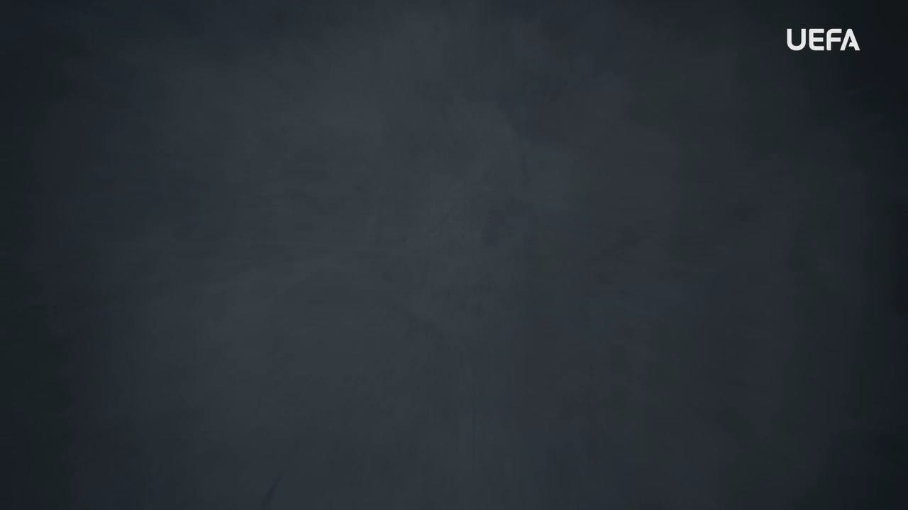
INTRODUCTION
WELCOME
Welcome to this OUTRAGED Education Session.
SESSION AIMS:
Watch the UEFA OUTRAGED SEXISM video and then hold an open discussion about how we as individuals but also as a group, can look to ensure that sexism has no place in football.
Notes:
This section outlines a suggested text to use as an introduction to the session:
“Welcome to this OUTRAGED session. The aim is for us to come together to watch the UEFA video on sexism, and then hold an open discussion about preventing and fighting this form of discrimination in football. I am here as your session leader today. I am happy to be able to share this experience with you, and hope that we can come together to create a safe and open space for discussion. Together we will look at how we as individuals but also as a group, can look to ensure that sexism has no place in football. When speaking about sexism, we speak about hateful and discriminatory actions, activities, words, and symbols that are based on the idea that one sex/or gender identity is superior to another. This is not the case. Sexism comes with a range of issues, for example creating challenges for women to be given the same respect as men or creating stereotypes around what is considered the role of a man or a woman. Sexism has no place in football. As players, and as a team, you can all play a part in ensuring that no one faces sexism within the game. The work we do here today is a part of the UEFA OUTRAGED educational project, and I will provide them some key information about the session. If you feel like you would like to speak further about any of the aspects we cover today, please reach out to me in the end of the session.
UEFA, the Football Association of Wales and (INSERT CLUB NAME) thanks you for being a part of this project, and this session is one of many which will look to change the football environment for the better.”

Slide 3
PART 1:
OUTRAGED
VIDEO VIEWING

Slide 4

OUTRAGED VIDEO
Let’s watch the OUTRAGED SEXISM video!
Notes:
https://www.uefa.tv/video/vod/376094/?playlistId=11230

Slide 5
PART 2:
DISCUSSION

Slide 6
DISCUSSION
SEXISM IN FOOTBALL
Throughout the video, we see many aspects of Sexism mentioned.
Q: Why do you think girls and women are treated differently in football?
Group conversation prompts:
Do you think we should all have the same opportunity to play and be a part of football?
Are there stereotypes about girls and women’s sporting abilities which might cause this?”
Notes:
There is no need to cover all topics and questions. These are provided to ensure there is content for discussion, but engagement is the key, not how many topics or questions you get through! There may be topics not listed below that you feel are relevant to your group. Please amend/adapt the questions and topics as you see fit and let the group guide the discussion where possible.

Slide 7
DISCUSSION
PLAYING FOOTBALL TOGETHER
In football, we separate players based on their sex, the men’s and women’s game.
Q: In grassroots football, there are mixed teams playing football. What do you think can be the benefits of this?
Group conversation prompts:
Would it make it more of a game that is shared with everyone?
Would it make any difference in who players connect with and interact with?
Notes:
There is no need to cover all topics and questions. These are provided to ensure there is content for discussion, but engagement is the key, not how many topics or questions you get through! There may be topics not listed below that you feel are relevant to your group. Please amend/adapt the questions and topics as you see fit and let the group guide the discussion where possible.

Slide 8
DISCUSSION
LGBTQI+ INCLUSION
The game has a history of being seen as a man’s game, but more and more women and girls are playing, coaching, refereeing, and watching football.
Q: What do you think should be the key for anyone being a part of football?
Group conversation prompts:
Should they like the sport?
Should they want to spend time within a team, a club, or a football organisation?
Does who you are really matter?
Notes:
There is no need to cover all topics and questions. These are provided to ensure there is content for discussion, but engagement is the key, not how many topics or questions you get through! There may be topics not listed below that you feel are relevant to your group. Please amend/adapt the questions and topics as you see fit and let the group guide the discussion where possible.

Slide 9

QUESTIONS?
THOUGHTS & FEEDBACK
Do you have any questions?
Notes:
There is no need to cover all topics and questions. These are provided to ensure there is content for discussion, but engagement is the key, not how many topics or questions you get through! There may be topics not listed below that you feel are relevant to your group. Please amend/adapt the questions and topics as you see fit and let the group guide the discussion where possible.

Slide 10

FURTHER SUPPORT
If you experience discrimination or have any concerns, contact….
Notes:
Provide details of dedicated contact person at your Club i.e. safeguarding officer or Liaison Officer.

Slide 11


Notes:
“Thank you all for your work here today. I hope that you all take three things away from today:
1. We all play a role in making sure that football is welcoming for all – you, your club, the National Association and UEFA.
2. Discrimination should never be accepted, and it is key that you feel comfortable speaking about these topics and know where to turn if you need support or to report an incident.
3. We are all here because of our love for football – let us leverage this to build an environment that represents values of respect, openness, and inclusion.
Based on these three things, you’ll be a part of the OUTRAGED educational project, working to make sure that there is no place for discrimination in European football.”

